Slide 1

What is a Primary key?
PRIMARY KEY is a column or group of columns in a table that uniquely identify every row in that table. The Primary Key can't be a duplicate meaning the same value can't appear more than once in the table. A table cannot have more than one primary key.
Rules for defining Primary key:
  Two rows can't have the same primary key value.
  It must for every row to have a primary key value.
  The primary key field cannot be null.
  The value in a primary key column can never be modified or updated if any foreign key refers to that primary key.
StudID | Roll No | FirstName | LastName | Email
1 | 11 | Tom | Price | abc@gmail.com
2 | 12 | Nick | Wright | xyz@gmail.com
3 | 13 | Dana | Natan | mno@yahoo.com
Here
StudID is the primary key

Slide 2
What is the alternate keys?
ALTERNATE KEYS is a column or group of columns in a table that uniquely identify every row in that table. A table can have multiple choices for a primary key but only one can be set as the primary key. All the keys which are not primary key are called an Alternate Key.
Example:
  In this table, StudID, Roll No, Email are qualified to become a primary key.
  But since StudID is the primary key, Roll No, Email becomes the alternative key.
StudID | Roll No | FirstName | LastName | Email
1 | 11 | Tom | Price | abc@gmail.com
2 | 12 | Nick | Wright | xyz@gmail.com
3 | 13 | Dana | Natan | mno@yahoo.com

Slide 3
What is candidate keys?
CANDIDATE KEY is a set of attributes that uniquely identify tuples in a table. Candidate Key is a super key with no repeated attributes. The Primary key should be selected from the candidate keys. Every table must have at least a single candidate key. A table can have multiple candidate keys but only a single primary key.
Properties of Candidate key:
  It must contain unique values
  Candidate key may have multiple attributes
  Must not contain null values
  It should contain minimum fields to ensure uniqueness
  Uniquely identify each record in a table

Slide 4

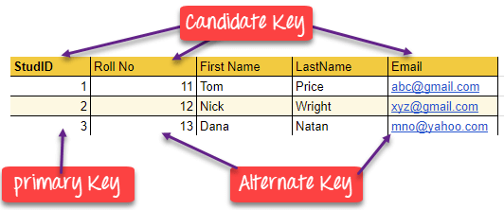
Example:
In the given table Stud ID, Roll No, and email are candidate keys which help us to uniquely identify the student record in the table.
Primary key + Alternate key= Candidate Key

Slide 5
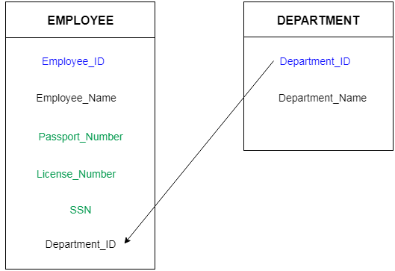
What is foreign key?
Foreign keys are the column of the table which is used to point to the primary key of another table.
In a company, every employee works in a specific department, and employee and department are two different entities. So we can't store the information of the department in the employee table. That's why we link these two tables through the primary key of one table.
We add the primary key of the DEPARTMENT table, Department_Id as a new attribute in the EMPLOYEE table.
Now in the EMPLOYEE table, Department_Id is the foreign key, and both the tables are related.

Slide 6
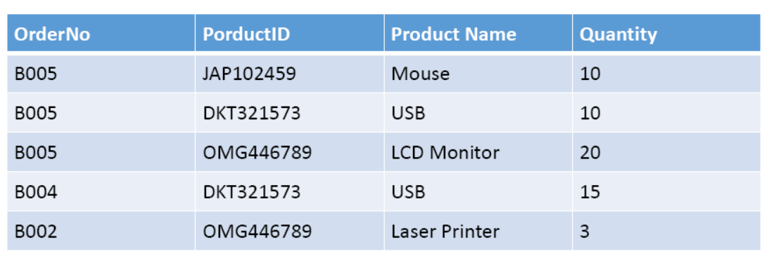
What is COMPOUND KEY ?
COMPOUND KEY has two or more attributes that allow you to uniquely recognize a specific record. It is possible that each column may not be unique by itself within the database. However, when combined with the other columns the combination of composite keys become unique. The purpose of the compound key in database is to uniquely identify each record in the table.

Slide 7
In this example, OrderNo and ProductID can't be a primary key as it does not uniquely identify a record.
However, a compound key of Order ID and Product ID could be used as it uniquely identified each record

Slide 8
Difference Between Primary key & Foreign key
Primary Key | Foreign Key
Helps you to uniquely identify a record in the table. | It is a field in the table that is the primary key of another table.
Primary Key never accept null values. | A foreign key may accept multiple null values.
Primary key is a clustered index and data in the DBMS table are physically organized in the sequence of the clustered index. | A foreign key cannot automatically create an index, clustered or non-clustered. However, you can manually create an index on the foreign key.
You can have the single Primary key in a table. | You can have multiple foreign keys in a table.

Slide 9
Thank you

